Slide 1

A.I.D.A
Artificially Intelligent Digital Agent
TNB Chatbot Hackathon
15th Dec 2017

Slide 2
Content
About the Speaker
Problem Statement
Solution Demo

Slide 3
The opportunity is >RM50mil a year
Outage Savings
Over RM4mil a year is lost based on TNB’s SAIDI of 50 mins and revenue of RM42bil a year
Outage Mgnt Automation
Over 176 staff deployed in CareLine CNC answering on average 200k outage calls a year costing around RM16mil per year
01
Power
Outage
02
Call Centre Automation
Over 77 staff deployed in CareLine OMS answering on almost a million calls a year costing around RM5mil per year
Credit Mgnt Automation
Over RM3bil in customer debt unpaid or ageing and over 50 FTE for calling customers
Account Management
03
Engage Socially
>190K Facebook followers but only 4 FTE to reply in a few hours and only on working hours, replying to around 20k emails and chats a month
General
Enquiries
04
Global
Support
Global Support Service
>38,000 employees relying on manual helpdesks to get Finance, Legal, IT and HR Support only during working hours

Slide 4
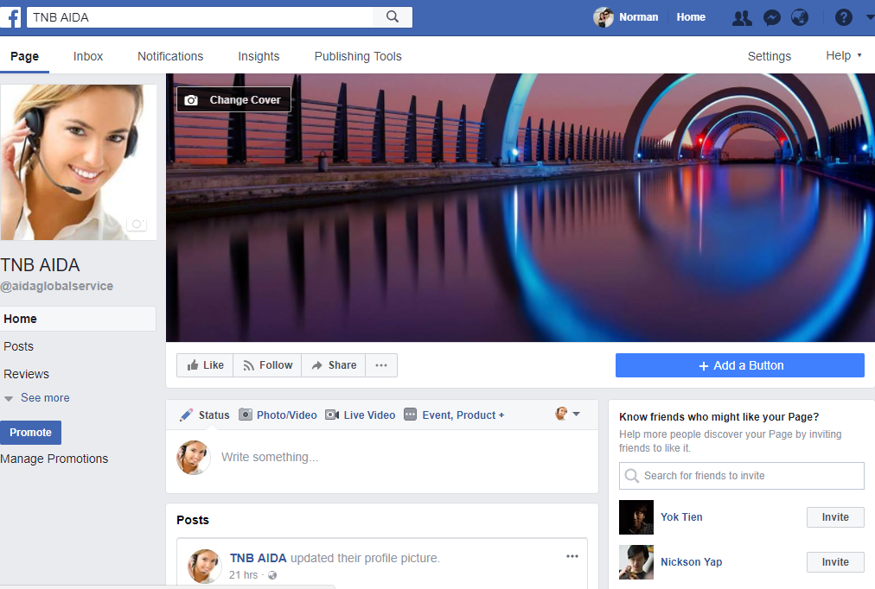

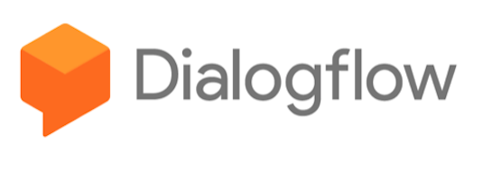
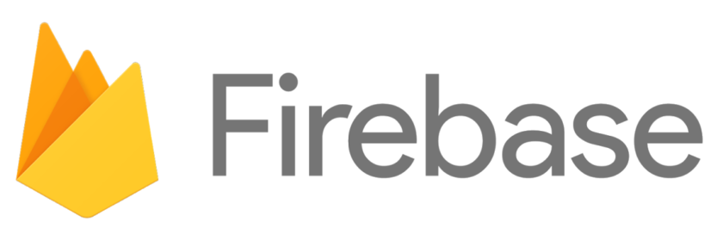

AIDA is powered by Cloud Solutions

Slide 5
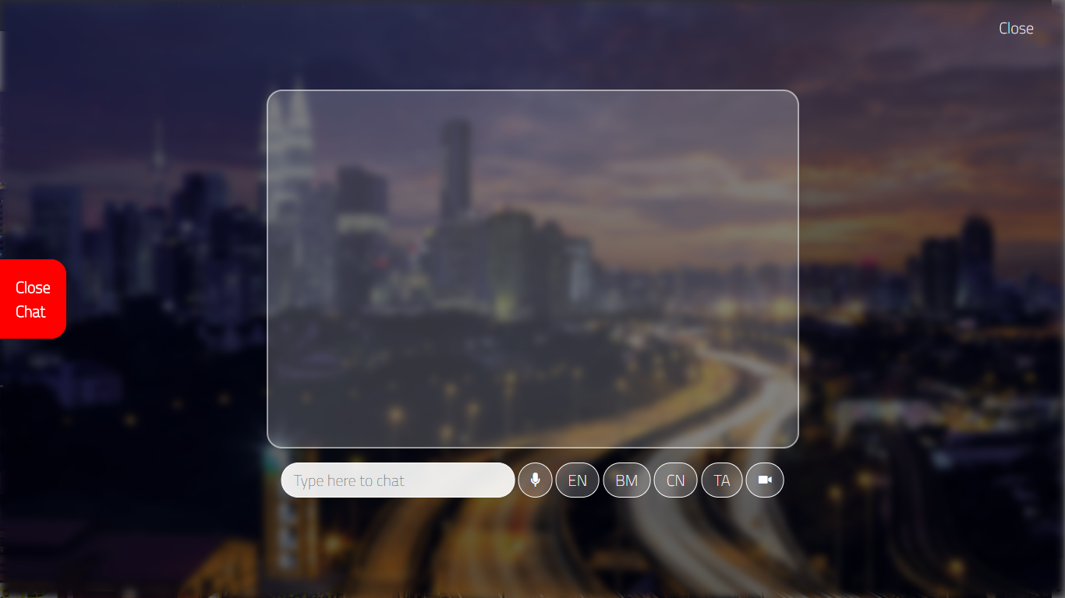
Web Demo

Slide 6
Platform Architecture
Artificially Intelligent Digital Assistant
Multi Platform Connectors
Machine
Learning
Cognitive Intelligence
Business Intent
Emotional
Analysis
Helpdesk
Support
Web
Facebook
Natural Language
iOS
WhatsApp
Human
Escalation
Social Media
Engagement
English
Mandarin
Android
Skype
PhoneGap
Twitter
Training
Account
Management
SMS
Viber
Real-Time Translator
Calls
Line
Malay
Tamil
Self Learning
Outage
Management
Alexa
Realtime NoSQL Database
Business API Layer

Slide 7
Details – 1. Flexible Infra
It is all cloud
No CAPEX
Pay for only what you use
Super Scalable

Slide 8
Details – 2. Local Support
We’re close by
Accenture Office in Gardens
Google office in KL Sentral

Slide 9
Details – 3. Integration & Support
Platform agnostic REST APIs on https
Wide range of integration points
Web
iOS
Android
PhoneGap
SMS
Calls
Facebook
WhatsApp
Skype
Viber
Line
Twitter
Alexa

Slide 10
Details – 4. AI Ability
It’s Contextual with Machine Learning
It’s Personal
Voice Recognition
Image Recognition
Sentiment Analysis

Slide 11
Details – 5. Language
English (Speech + Voice)
Malay (Speech Only)
Mandarin (Speech + Voice)
Tamil (Speech Only)
1337 Checking

Slide 12
Details – 6. Training
It’s Straight Forward to Train to Some extent
Rule Based – No Skills Required
Mass Upload
User flows – Some skills required
Self-Learning – Tells you gaps

Slide 13
Credentials in Chatbots
Avianca Airlines Chatbot https://www.accenture.com/us-en/success-avianca-airlines-new-chatbot-reducing-travel-stress
Accenture Amelia http://www.thedrum.com/news/2016/05/17/accenture-creates-artificially-intelligent-agent-amelia-inspire-firms-embrace
Applyr https://innovation-awards.nl/innovation/the-most-human-recruitment-chatbot-solution/
BBC https://www.accenture.com/no-en/_acnmedia/PDF-42/Accenture-CSB01344-BBC-Security-Credential.pdf
South by Southwest Film Festival 2017 https://www.youtube.com/watch?v=rH_B9LGSUcU

Slide 14
Thank you

